Slide 1
PERSONAL PORTFOLIO
Akshit Chauhan
Group-28
2110990133

Slide 2
About Project
I Have Created a Personal Portfolio using Html, CSS and JavaScript which includes some projects like Tic Tac Toe, Temperature Converter, BMI Calculator and To Do List.
A personal portfolio is a curated collection of an individual's work, achievements, skills, and experiences. It serves as a visual and often digital representation of one's professional and personal journey. Typically used by professionals, artists, designers, writers, and anyone looking to showcase their abilities, a personal portfolio provides a comprehensive overview of a person's capabilities and accomplishments. It can include items such as work samples, projects, artwork, certifications, academic achievements, and more, all presented in a visually appealing and organized manner. Personal portfolios are often used for job applications, freelance opportunities, college admissions, or simply to share one's passions and expertise with the world. They offer a powerful means of self-expression and are an essential tool for establishing one's credibility and personal brand in a digital age.

Slide 3
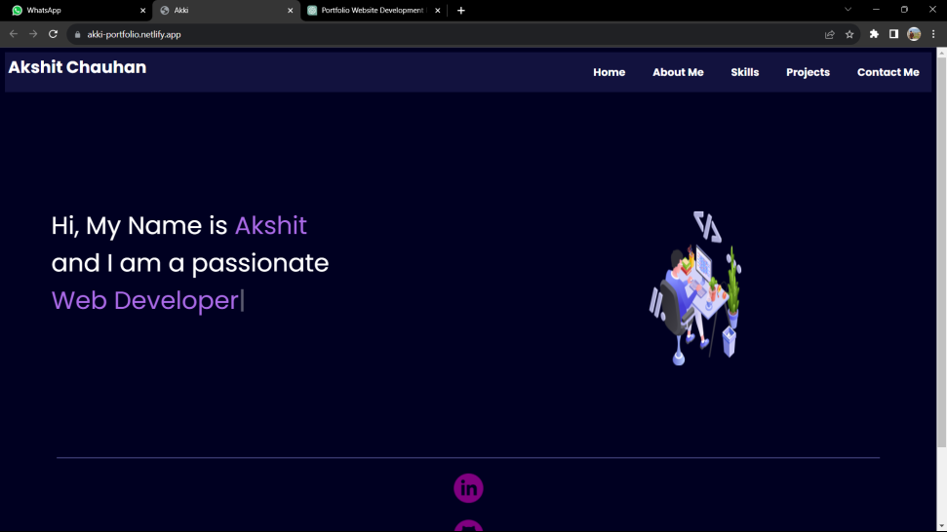
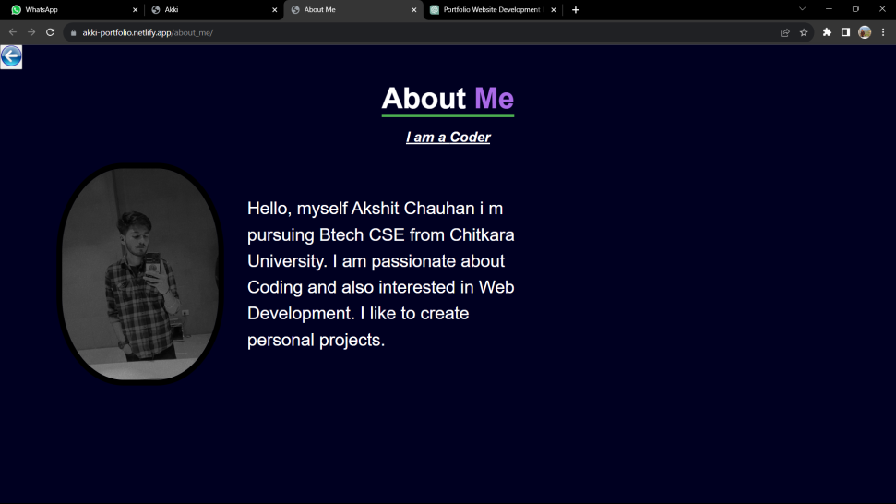
PORTFOLIO

Slide 4
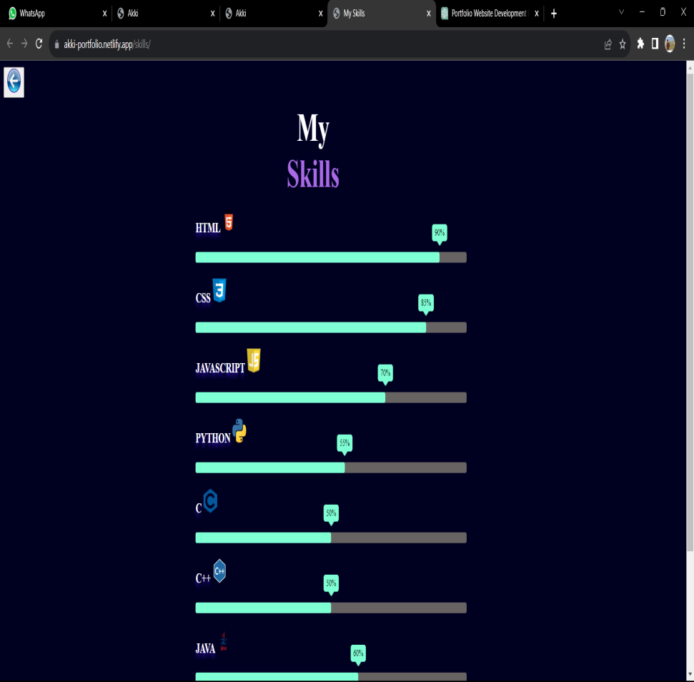
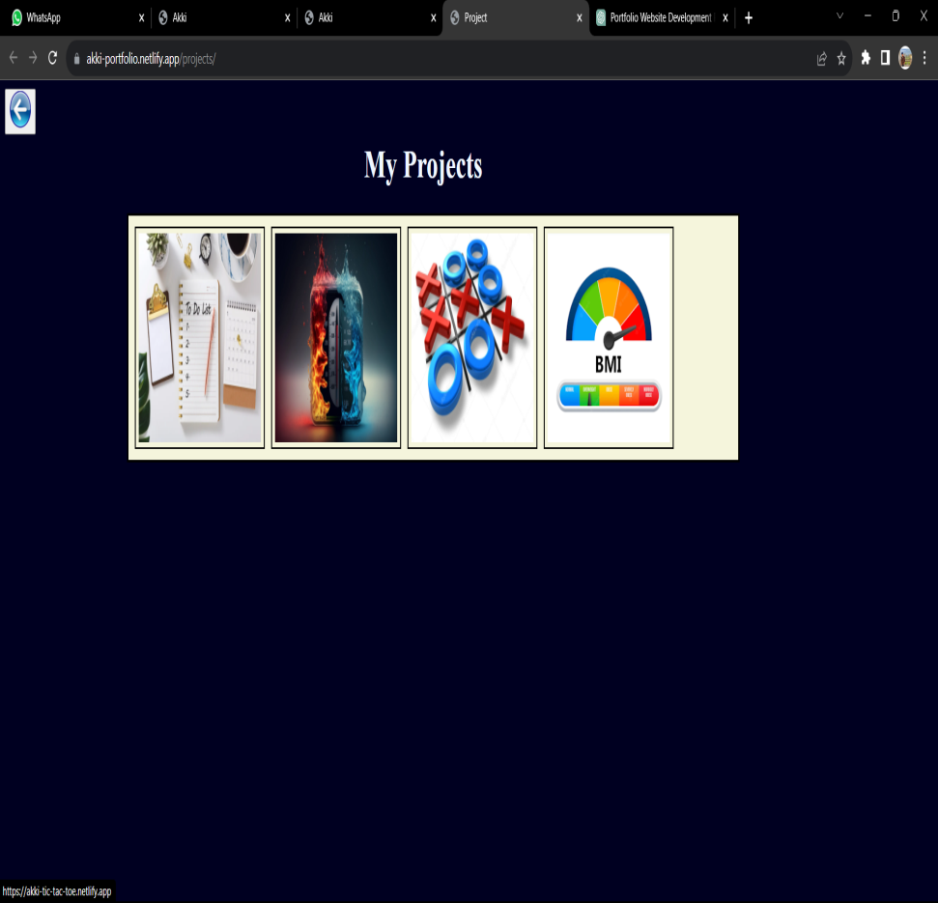
PORTFOLIO

Slide 5
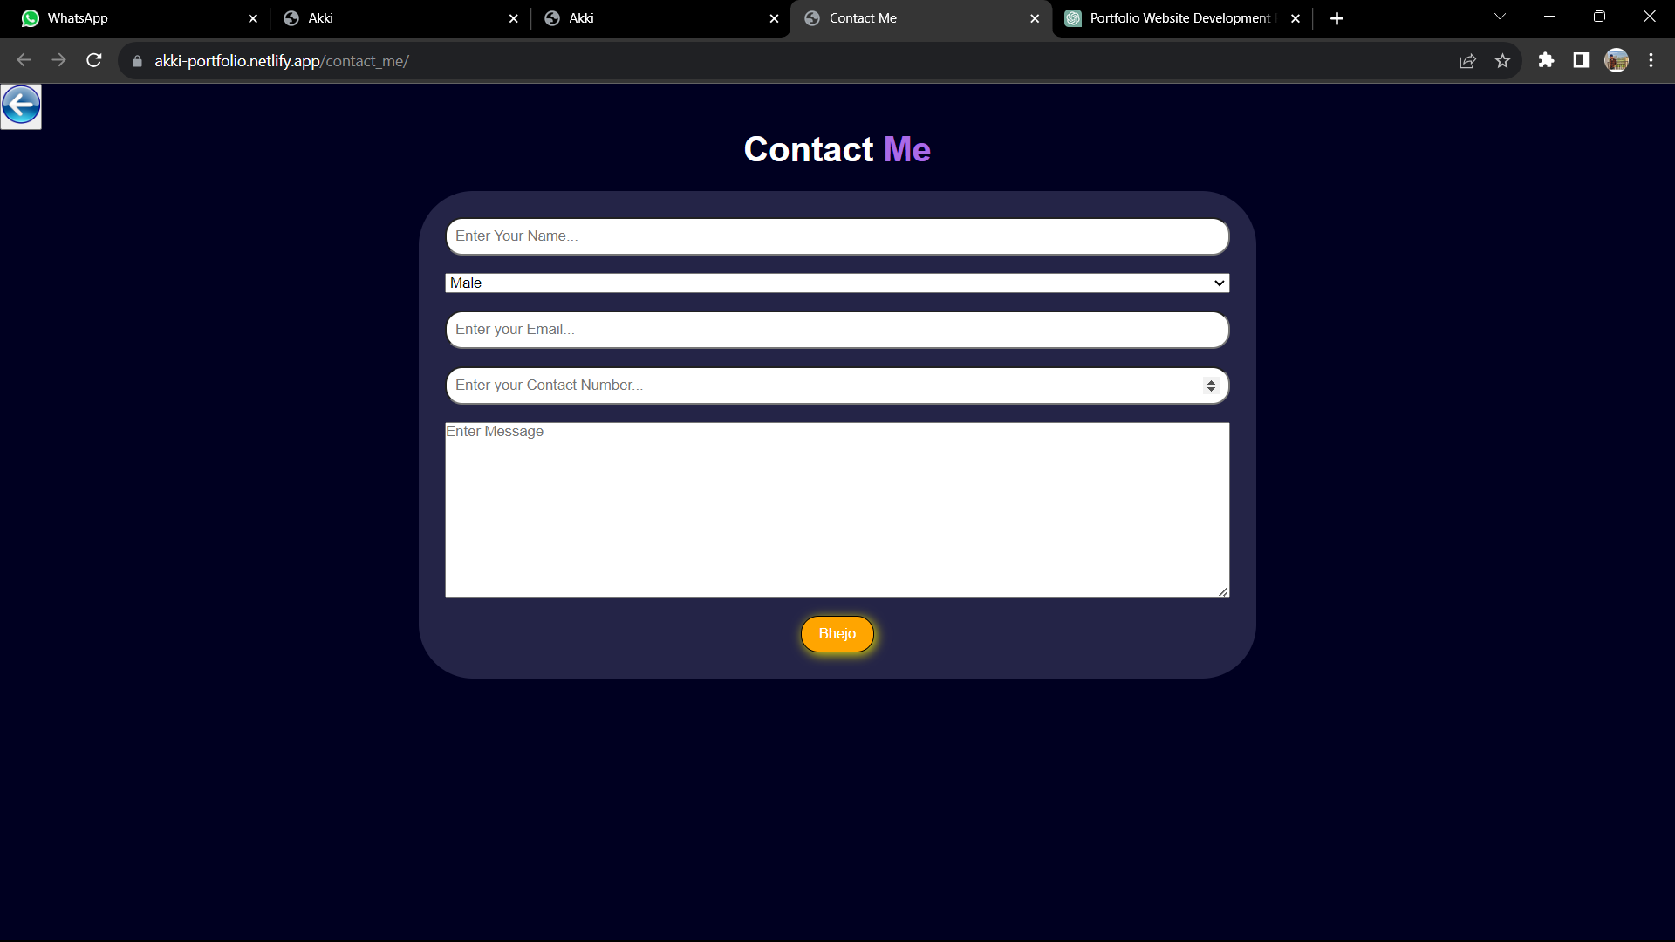
PORTFOLIO

Slide 6
To DO List
The To-Do List project is a task management application designed to help individuals organize and prioritize their daily, weekly, or long-term tasks. This project aims to streamline task management, increase productivity, and provide a simple yet effective tool for keeping track of important responsibilities.
Objectives:
Create a user-friendly and efficient interface for adding, organizing, and managing tasks.
Implement features for setting due dates, priorities, and task categories.
Enable users to mark tasks as completed and maintain an organized task list.
Ensure accessibility across multiple devices and platforms.
Features:
Task Creation and Management:
Allows users to add, edit, and delete tasks.
Provides fields for task name, description, due date, priority level, and category.
Prioritization and Categorization:
Enables users to assign priority levels (e.g., high, medium, low) to tasks.
Allows categorization of tasks into different categories or projects.
Accessibility and Responsiveness:
Ensures the to-do list is accessible and functional on various devices, including desktop computers, smartphones, and tablets.
Benefits:
Helps users stay organized, focused, and productive by managing their tasks effectively.
Promotes better time management by prioritizing and categorizing tasks.
Reduces stress by offering reminders and notifications for important deadlines.
Provides an easy-to-use and customizable tool for task management and planning.
Encourages a sense of accomplishment by allowing users to track completed tasks.
Conclusion: The To-Do List project is a valuable tool for anyone seeking an efficient way to manage tasks and responsibilities. With its user-friendly interface, customizable features, and accessibility across multiple devices, it offers a versatile solution for task organization, productivity, and time management. Whether for personal use or professional purposes, this project is a valuable asset for those looking to streamline their daily tasks.

Slide 7
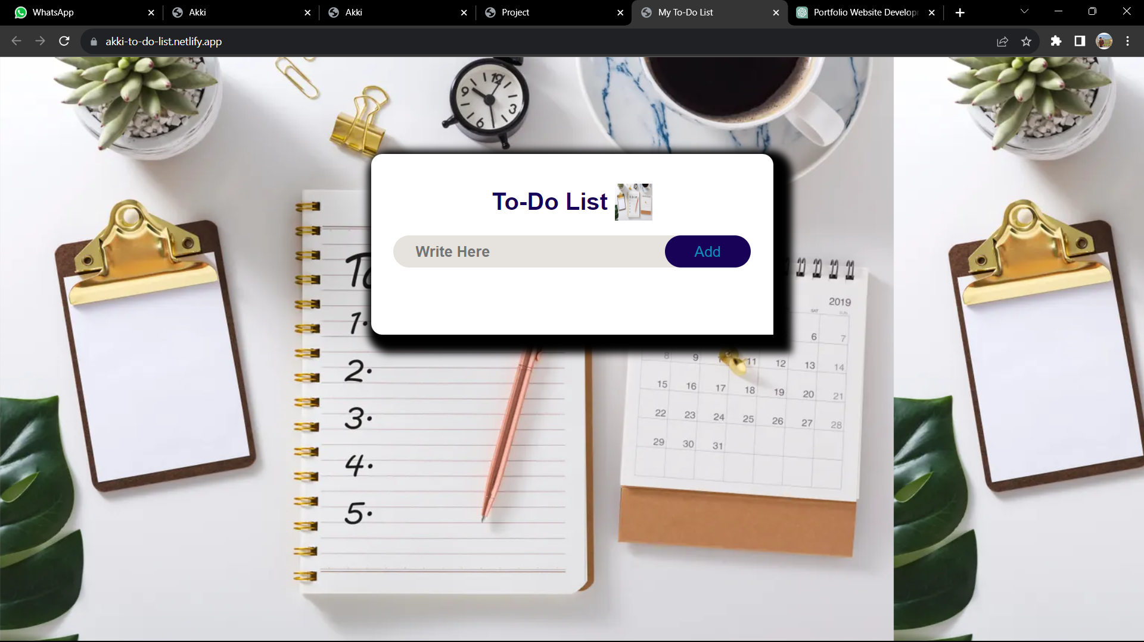
TO-DO LIST

Slide 8
Temperature Converter
The Temperature Converter project is a versatile software application designed to help users convert temperatures between different measurement units and scales. This project serves as a handy tool for a wide range of applications, from everyday life to scientific and industrial settings, providing quick and accurate temperature conversions.
Objectives:
Create an intuitive and user-friendly interface for inputting temperature values.
Implement conversion formulas for various temperature scales, such as Celsius, Fahrenheit, Kelvin, and more.
Offer real-time and accurate temperature conversions.
Allow users to easily switch between different temperature scales.
Ensure compatibility with different devices and platforms.
Features:
User Input:
Provides fields for users to input temperature values in one scale.
Offers input validation and error handling to prevent inaccurate data entry.
Temperature Conversion:
Implements conversion formulas for various temperature scales, including Celsius, Fahrenheit, Kelvin, and potentially others.
Converts temperatures accurately and in real-time, displaying the result immediately.
Scale Switching:
Allows users to easily switch between different temperature scales, selecting the source and target scales.
Offers a wide range of temperature units for conversion.
Responsive Design:
Ensures the converter is accessible and functional on various devices, including desktop computers, smartphones.
Benefits:
Provides a versatile tool for converting temperatures, which is useful in a wide range of fields, including cooking, meteorology, science, and industry.
Promotes ease of use and convenience by offering real-time, accurate conversions.
Encourages learning and understanding of different temperature scales.
Can be used as an educational tool in science and mathematics classes.
Helps individuals and professionals perform temperature conversions with confidence.
Conclusion:
The Temperature Converter project is a valuable tool for users who need to convert temperatures between different scales. With its intuitive interface, accurate conversions, and customizable features, it offers a versatile solution for everyday use, educational purposes, and professional applications. Its compatibility with various devices and commitment to user data privacy make it a reliable and accessible resource for temperature conversion needs.

Slide 9
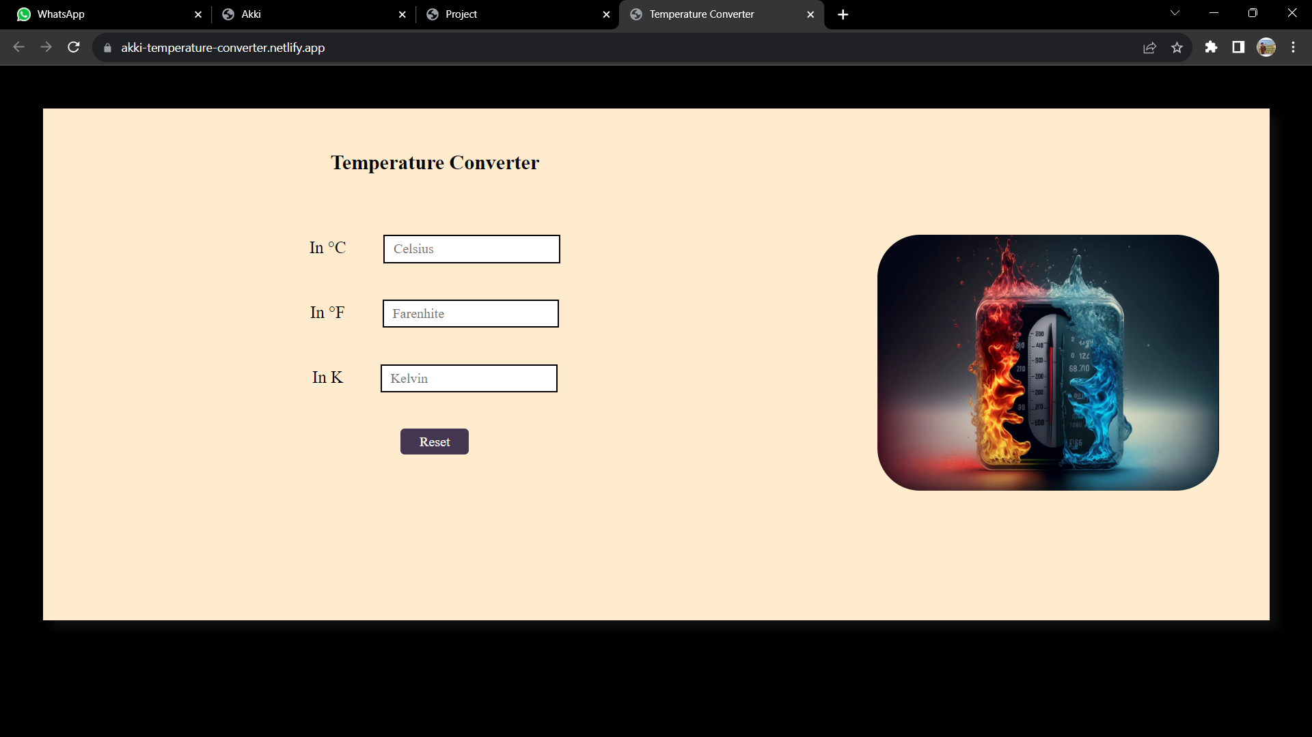
Temperature Convertor

Slide 10
Tic Tac Toe
The Tic-Tac-Toe project is a classic game implementation designed to provide an entertaining and educational experience for players of all ages. This project aims to create a digital version of the traditional Tic-Tac-Toe game, which is known for its simplicity and strategic depth.
Objectives:
Create a user-friendly and visually appealing digital Tic-Tac-Toe game
Implement two-player modes.
Develop an intuitive user interface that allows players to interact seamlessly with the game.
Ensure the project is well-documented for future reference and learning.
Features:
Two-Player: Two players can compete against each other on the same device.
User Interface: a. A clean and user-friendly interface with a grid to display the Tic-Tac-Toe board. b. Interactive buttons for players to make their moves and restart the game. c. Visual cues for player turns, game outcomes, and valid move selections..
Win Detection: a. Real-time win detection to identify and announce the winner when a game concludes. b. Highlighting the winning line on the board for clarity.
Game Statistics: a. Tracking and displaying game statistics, including the number of wins, losses, and ties for both players (in two-player mode) or Responsive Design: a. Ensures compatibility with various screen sizes and devices.
Benefits:
Provides an engaging and fun gaming experience for users.
Enhances logical thinking and strategic planning
Can serve as a learning resource for those interested in game development and AI implementation.
Suitable for educational purposes in teaching programming concepts.
Conclusion:
The Tic-Tac-Toe project offers a modern and accessible way to enjoy this classic game. With its multiple game modes, interactive interface, it caters to a broad audience and serves as both entertainment and a learning resource in the field of game development and AI programming.

Slide 11
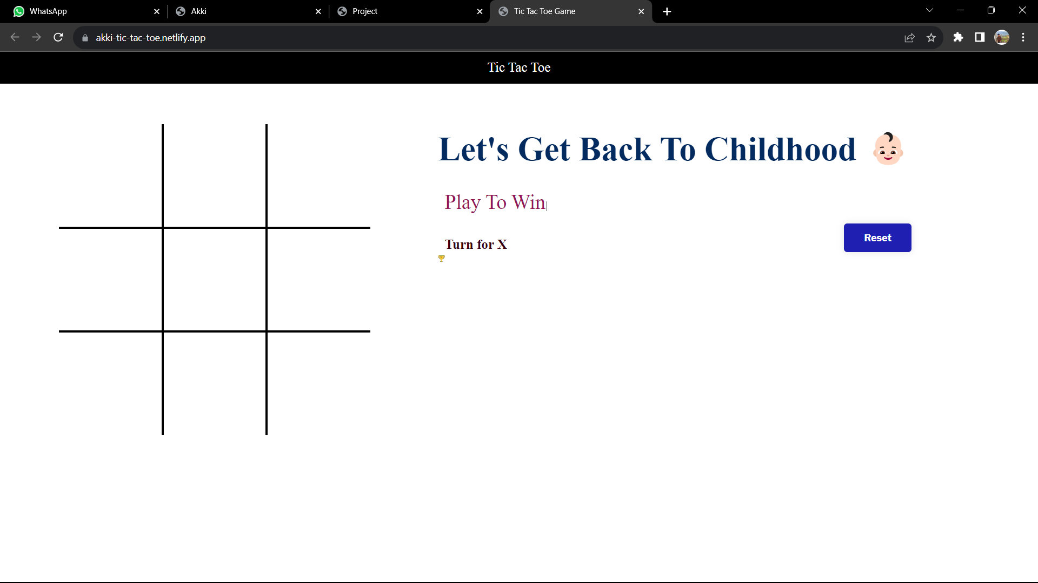
Tic Tac Toe

Slide 12
Bmi Calculator
The BMI (Body Mass Index) Calculator project is a software application designed to help individuals quickly and easily calculate their BMI, a widely used indicator of overall health and fitness. This project aims to provide a user-friendly tool that can assist people in assessing their body weight relative to their height and, consequently, make informed decisions about their health.
Objectives:
Create a simple, user-friendly interface for inputting weight and height measurements.
Implement the BMI calculation formula to provide accurate results.
Categorize BMI results into standard health categories (e.g., underweight, normal weight, overweight, and obese).
Educate users about the implications of their BMI results for health and well-being.
Ensure accessibility on various devices and platforms.
Features:
User Input:
Allows users to input their weight and height in metric or imperial units.
Offers validation and error handling to ensure accurate data entry.
BMI Calculation:
Utilizes the BMI formula: BMI = weight (kg) / (height (m) * height (m)) or BMI = (weight (lb) / (height (in) * height (in))) * 703 (for imperial units).
Calculates and displays the BMI value.
Health Categories:
Categorizes BMI results into standard health categories (e.g., underweight, normal weight, overweight, and obese).
Provides information and guidance on what each category means for an individual's health.
Safeguards user data and ensures that it is not stored or shared without permission.
Benefits:
Offers a quick and convenient way for individuals to assess their body mass index.
Promotes health awareness by categorizing results and providing valuable information about their implications.
Encourages users to make informed decisions about their lifestyle and fitness goals.
Can be used as an educational tool for health professionals, educators, and individuals seeking to understand BMI.
Conclusion:
The BMI Calculator project is a valuable and user-friendly tool for individuals to assess their BMI and gain insights into their health and fitness. With its straightforward interface, accurate calculations, categorization of results, and health guidance, it empowers users to take proactive steps toward improving their well-being. Additionally, its accessibility and privacy features make it a trustworthy and versatile resource for health-conscious individuals.

Slide 13
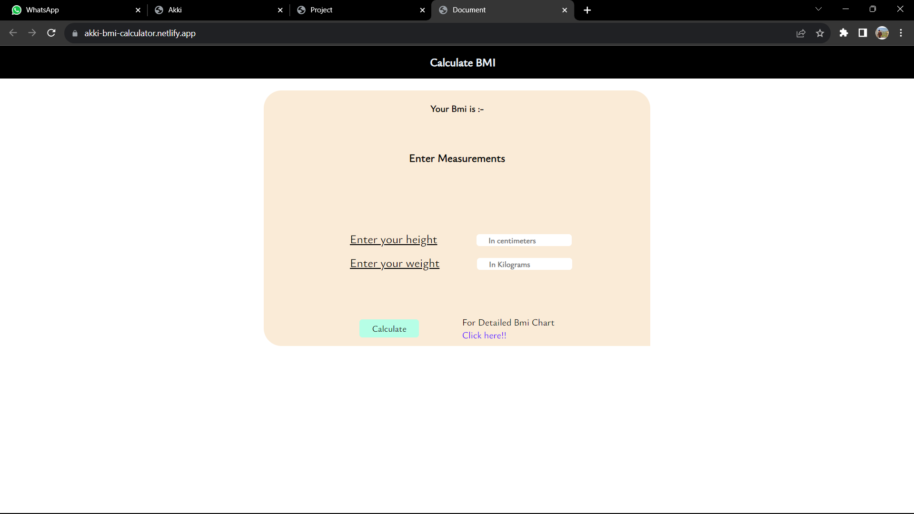
BMI Calculator

Slide 14
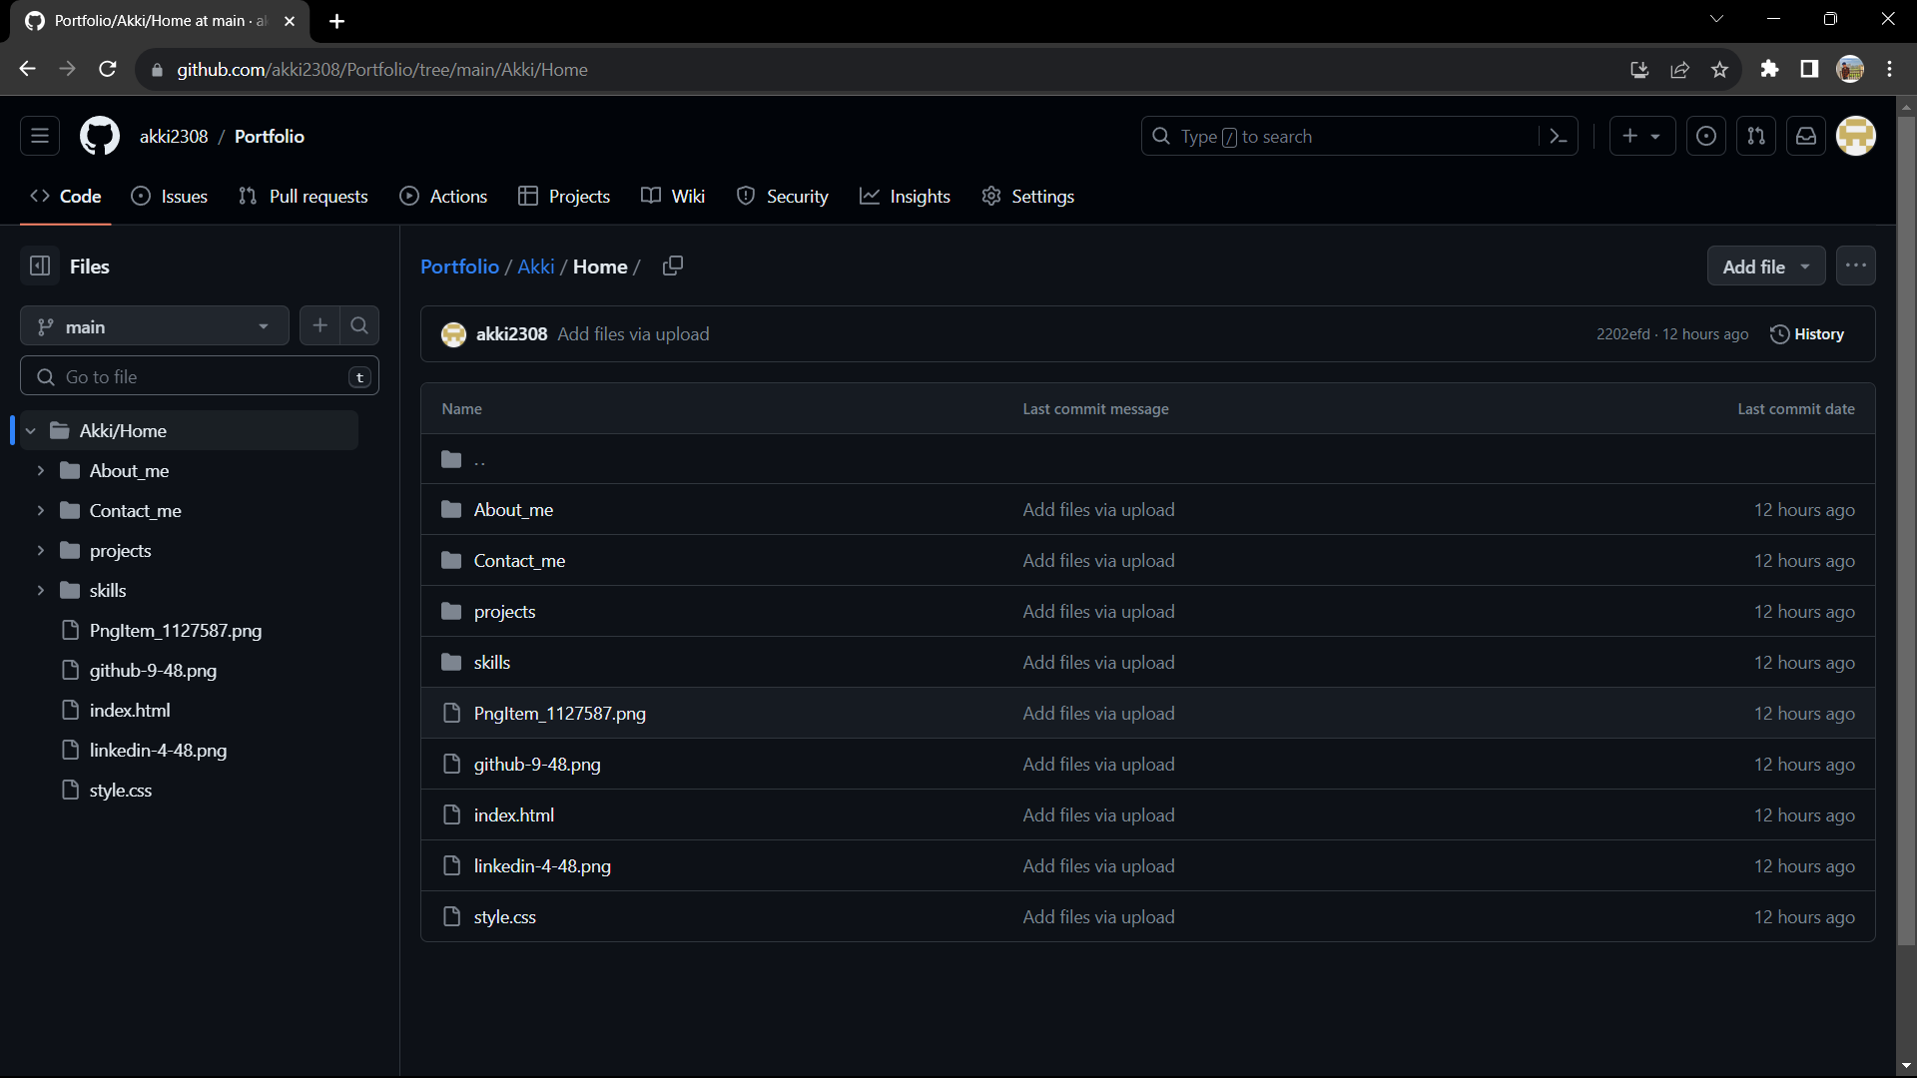
Git hub

Slide 15
Summary
The Personal Portfolio Website project aimed to develop a compelling and functional online platform to showcase the individual's skills, achievements, and personal brand. This project involved several key phases, including planning, design and development, content creation, testing, deployment, and ongoing maintenance.
The objectives of the project were to create a professional and visually appealing website that accurately represented the individual's identity and career highlights. The website featured an 'About Me' section, resume, project showcase, skillset details, and contact information. The project also included the selection of a domain name, hosting setup, and implementation of SEO practices for improved online visibility.
The outcome of the project was a successful personal portfolio website that fulfilled its goals. The website's user-friendly design, responsive layout, and SEO optimization contributed to increased organic traffic and enhanced personal branding. As an effective tool for self-promotion and networking, the portfolio provides valuable opportunities for personal and professional growth, making it a vital asset for the individual's career development. The project will be continually maintained and updated to ensure its ongoing relevance and effectiveness.

Slide 16
THANK YOU 😊

